Slide 1

A massive analysis of Italian open data quality
Master’s Degree Thesis
Candidate: Kristi Gjerko Supervisors: Prof. Antonio Vetrò Supervisors: Prof. Marco Torchiano A.Y. 2023-2024
Notes:
Good morning, today I will be presenting the Master’s Degree Thesis titled «A massive analysis of Italian open data quality»

Slide 2
A massive analysis of Italian open data quality
01. Introduction
02. Implementation
03. Live Demo
04. Conclusions
Notes:
This is the agenda for today and to introduce the topic and understand what it means let’s start from open data.

Slide 3
A massive analysis of Italian open data quality
01. Introduction
02. Implementation
03. Live Demo
04. Conclusions

Slide 4
A massive analysis of Italian open data quality
01. Introduction

Slide 5
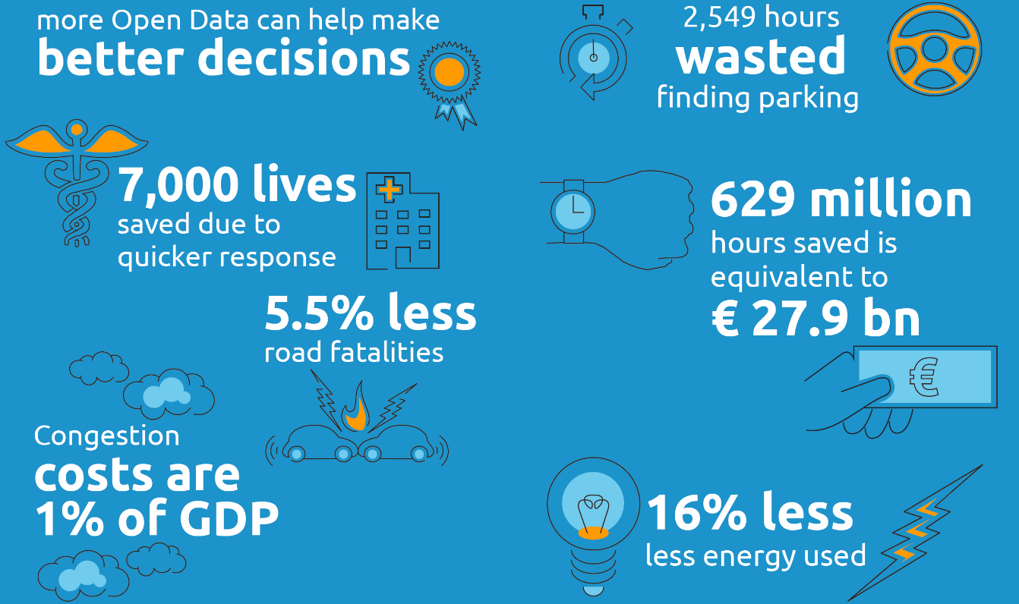

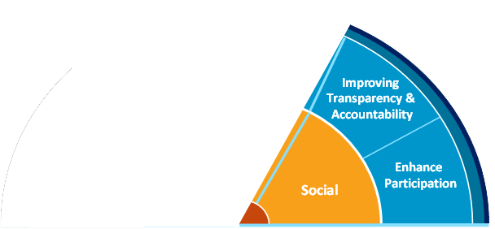
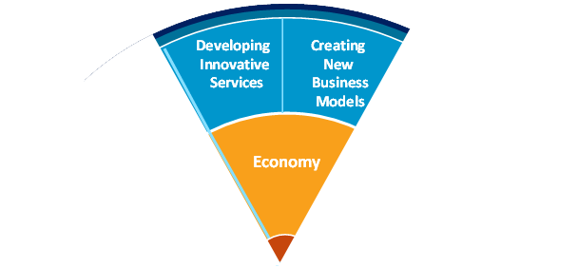
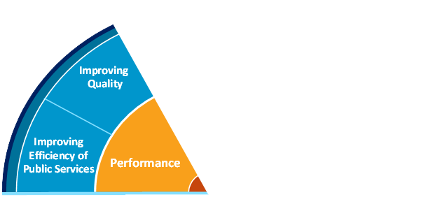

A massive analysis of Italian open data quality
data that can be freely used, modified, and shared by anyone for any purpose
01. Introduction
Notes:
-According to the Open Definition, open data is…. -The benefits of open data are diverse and range from improved efficiency of public services, economic growth in the private sector to wider social welfare.
-The European portal estimates that in 2020 alone, open data saved up to 1.7 bn euros in costs for public administrations.
-And now, to talk about open data in the public administration we move on to Italian Open Data and introduce dati.gov.it

Slide 6
A massive analysis of Italian open data quality
data that can be freely used, modified, and shared by anyone for any purpose
01. Introduction
Notes:
-According to the Open Definition, open data is…. -The benefits of open data are diverse and range from improved efficiency of public services, economic growth in the private sector to wider social welfare.
-The European portal estimates that in 2020 alone, open data saved public administrations 1.7 bn euros in costs.
-And now, to talk about open data in the public administration we move on to Italian Open Data and introduce dati.gov.it

Slide 7
A massive analysis of Italian open data quality
data that can be freely used, modified, and shared by anyone for any purpose
01. Introduction
Notes:
-According to the Open Definition, open data is…. -The benefits of open data are diverse and range from improved efficiency of public services, economic growth in the private sector to wider social welfare.
-The European portal estimates that in 2020 alone, open data saved public administrations 1.7 bn euros in costs.
-And now, to talk about open data in the public administration we move on to Italian Open Data and introduce dati.gov.it

Slide 8
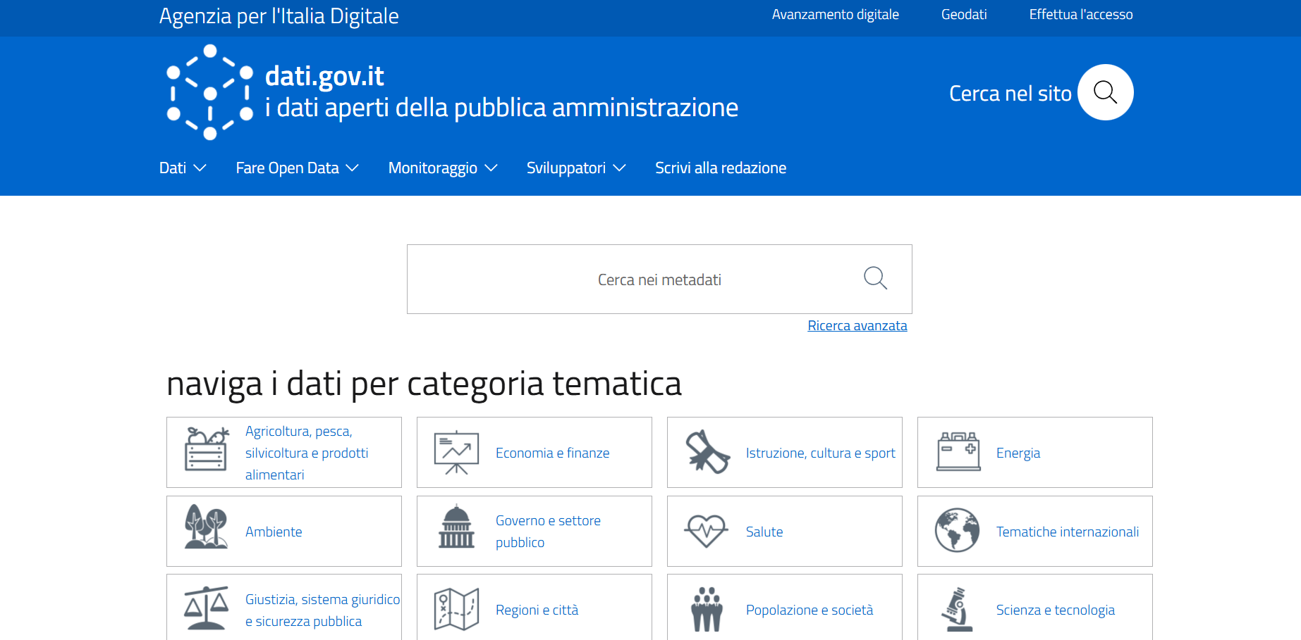
A massive analysis of Italian open data quality
dati.gov.it the Italian national catalog of open data and metadata of the public admininstration
in compliance with the European Directive on the reuse of public sector information
managed by the Agency for Digital Italy in collaboration with all the public entities that produce open data
01. Introduction
Notes:
-While open data promotes transparency and innovation, its impact is only as strong as its quality

Slide 9
A massive analysis of Italian open data quality
the degree to which data fulfills the needs of its intended use
high quality ensures that open data can be effectively
reused, analyzed, and trusted
without quality, open data risks becoming unreliable,
leading to flawed insights and diminished value
implemented according to the ISO/IEC 25012 and ISO/IEC 25024 standards, ensuring alignment with international benchmarks
01. Introduction

Slide 10
A massive analysis of Italian open data quality
a tool to conduct a massive evaluation and analysis of data quality
fully automated and large scale
continuous monitoring and integration
interactive analytic dashboards
10 quality measures
30k+ evaluated files
60k+ discovered files
01. Introduction
Notes:
-Now that we know why data quality is important, we need to conduct a massive analysis of it. -For this purpose, a tool has been developed that is fully automated and large scale. -This tool allows for continous monitoring of quality and continuous integration of new data.
-And provides interactive dashboards to analyze the results.
It evaluates quality across 10 different measures
More than 30k files have been already evaluated
And more than 60k files have been discovered

Slide 11
A massive analysis of Italian open data quality
01. Introduction
02. Implementation
03. Live Demo
04. Conclusions

Slide 12
A massive analysis of Italian open data quality
01. Introduction
02. Implementation
03. Live Demo
04. Conclusions
Notes:
Now let’s move on and see how the tool was implemented.

Slide 13
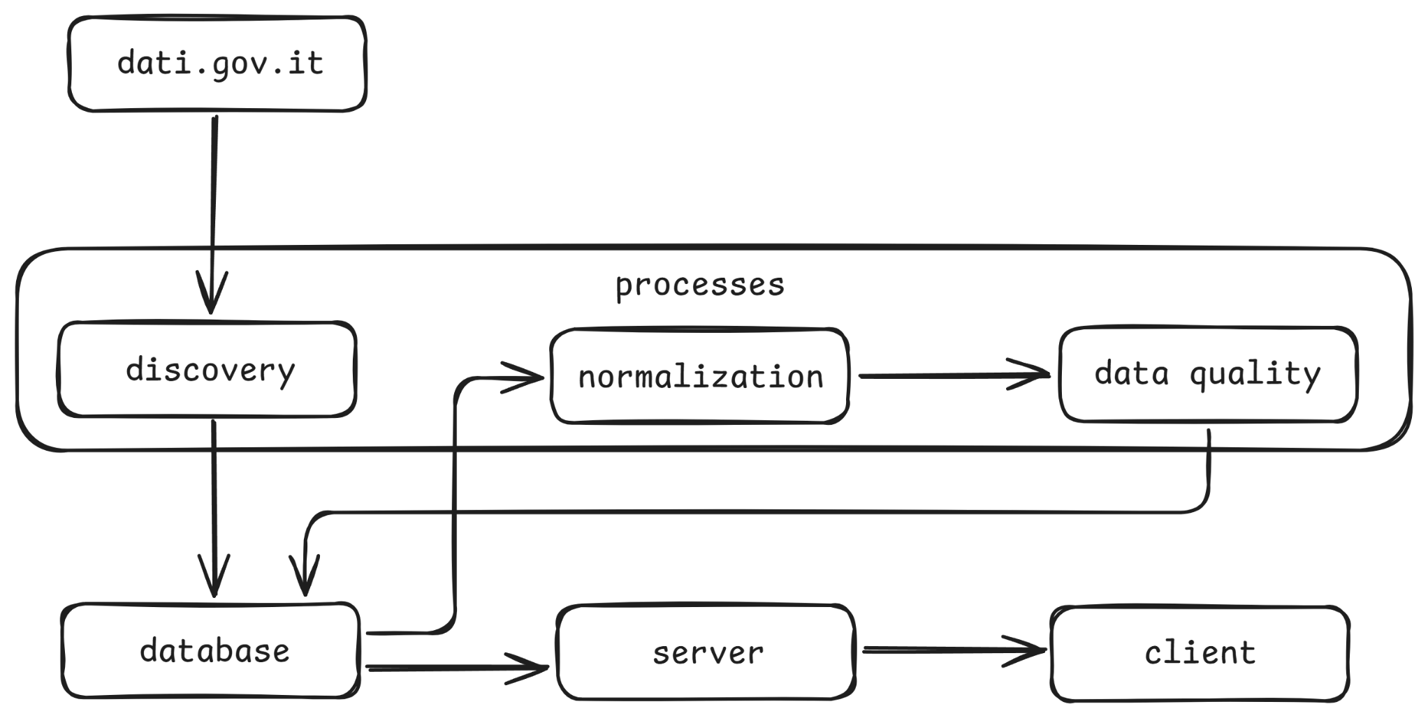
Architecture
02. Implementation
Notes:
This is the architecture of the tool and it also represents the way its components have been organized and deployed as services in Docker.

Slide 14
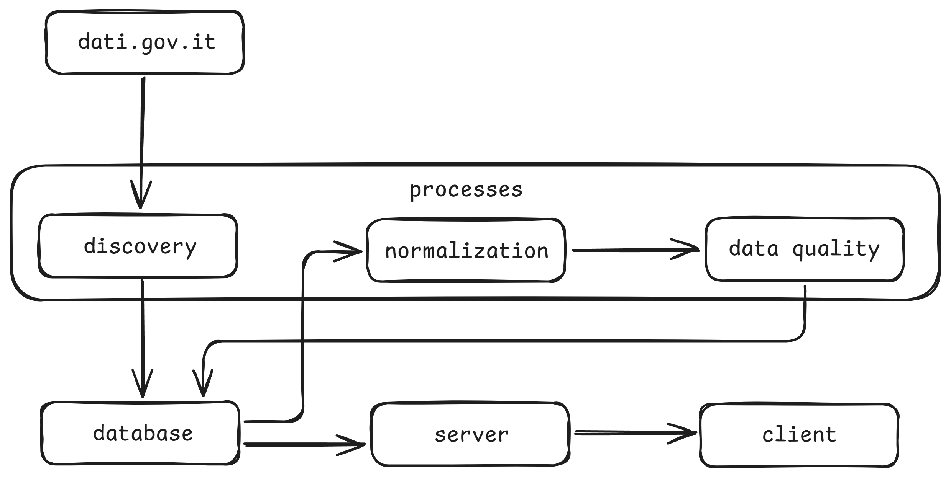
Data Source
02. Implementation
Notes:
The first component is the external data source.

Slide 15
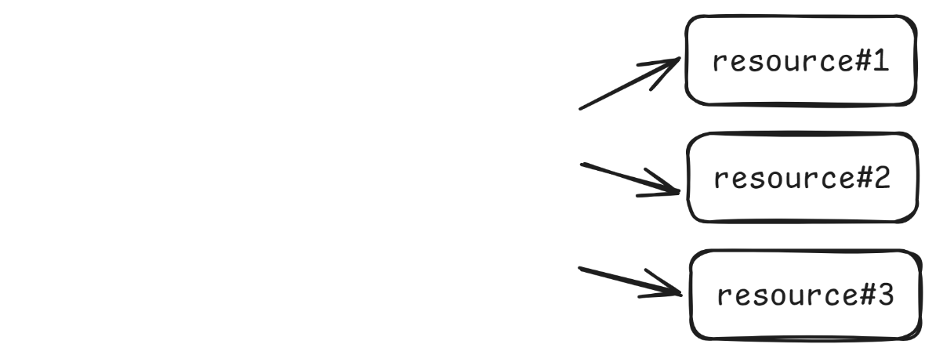
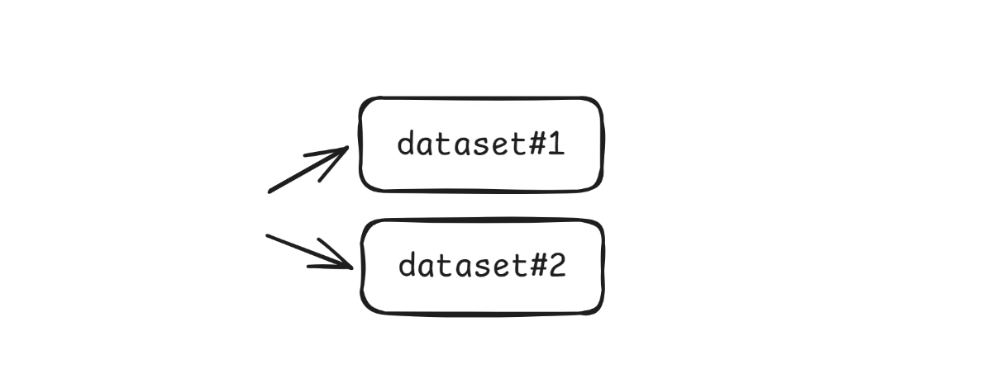
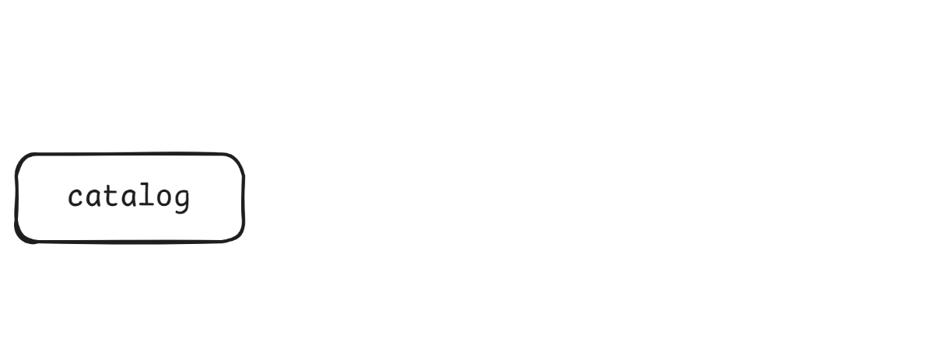

Data Source
dati.gov.it
centralized repository
of metadata
search and access point
for open data
catalog endpoint: https://dati.gov.it/opendata/api/3/action/package_list
dataset endpoint: https://dati.gov.it/opendata/api/3/action/package_show? id={dataset-id}
02. Implementation
Notes:
-All of this is made public through APIs and the first entry point is the catalog.
-The catalog is composed of datasets and each dataset is composed of one or more resources.
-A resource is the final data file that is the object of data quality assessment.

Slide 16
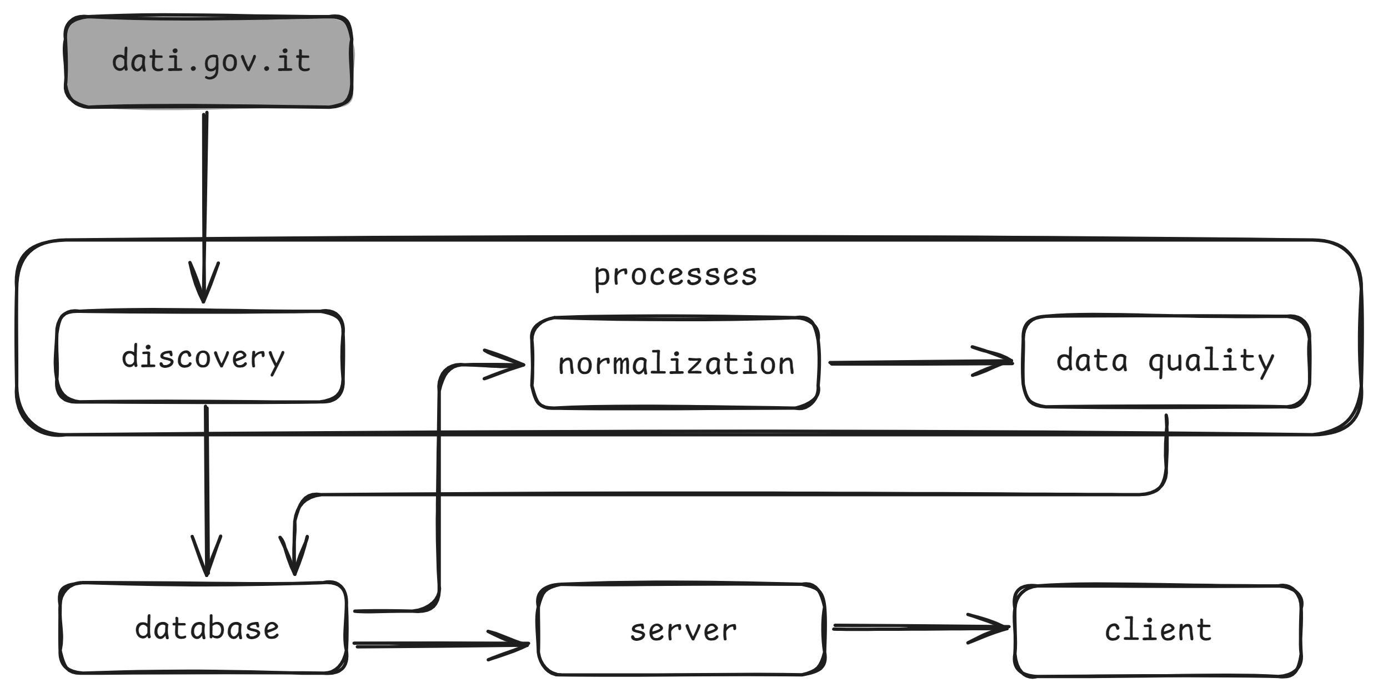
Data Discovery
02. Implementation
Notes:
To explore this huge catalog we make use of the data discovery process.

Slide 17

Data Discovery
automated process for identifying and registering datasets and resources in the tool’s internal database
implemented in Python and utilizes the dati.gov.it APIs
1. retrieve the metadata from the API
2. compare with the tool’s metadata
3. update the internal database accordingly
02. Implementation
Notes:
…. updates the internal database which is our next component.

Slide 18
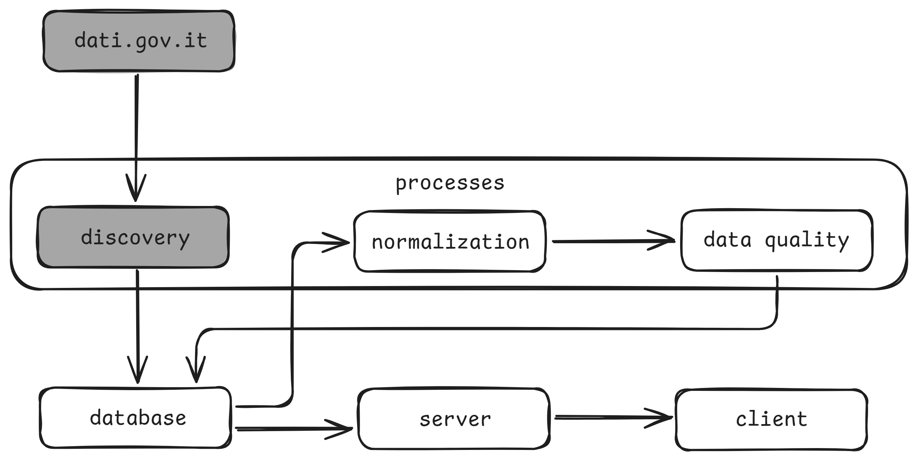
Database
02. Implementation

Slide 19
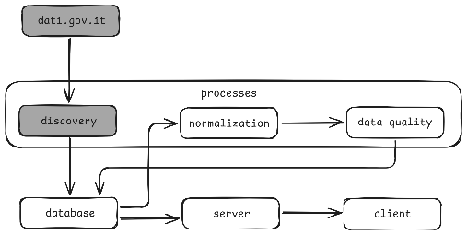
Database
central repository of the tool storing metadata, quality results, and logs
implemented in PostgreSQL with a schema that reflects
the logical structure of the data model
metadata resources datasets
datasets_groups
datasets_tags
data quality
measures quality
processes
log_exec log_csv
log_quality
02. Implementation
Notes:
It serves as the….

Slide 20
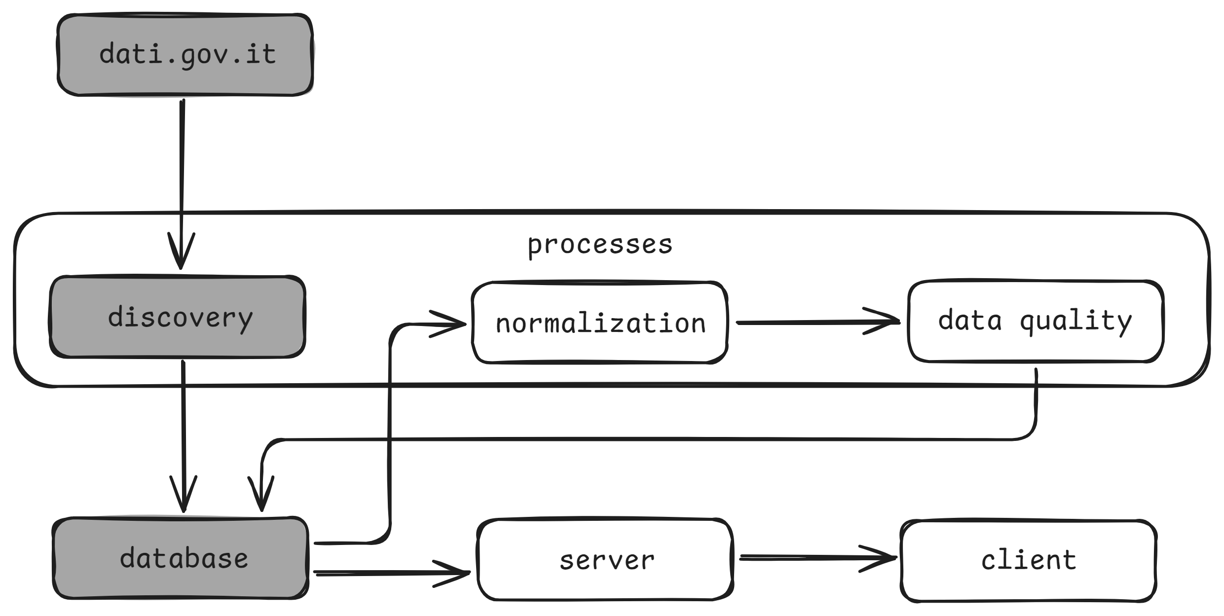
Data Normalization
02. Implementation
Notes:
Once the data has been discovered we move on to the normalization.

Slide 21
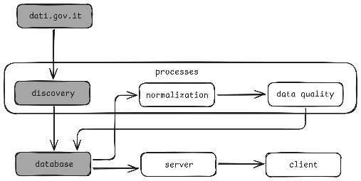
Data Normalization
automated process for transforming raw files
into structured formats
implemented in Python and processes CSV resources
1. retrieve the resource and decode its content
2. read a sample and detect its characteristics
3. transform the content into a dataframe
02. Implementation

Slide 22
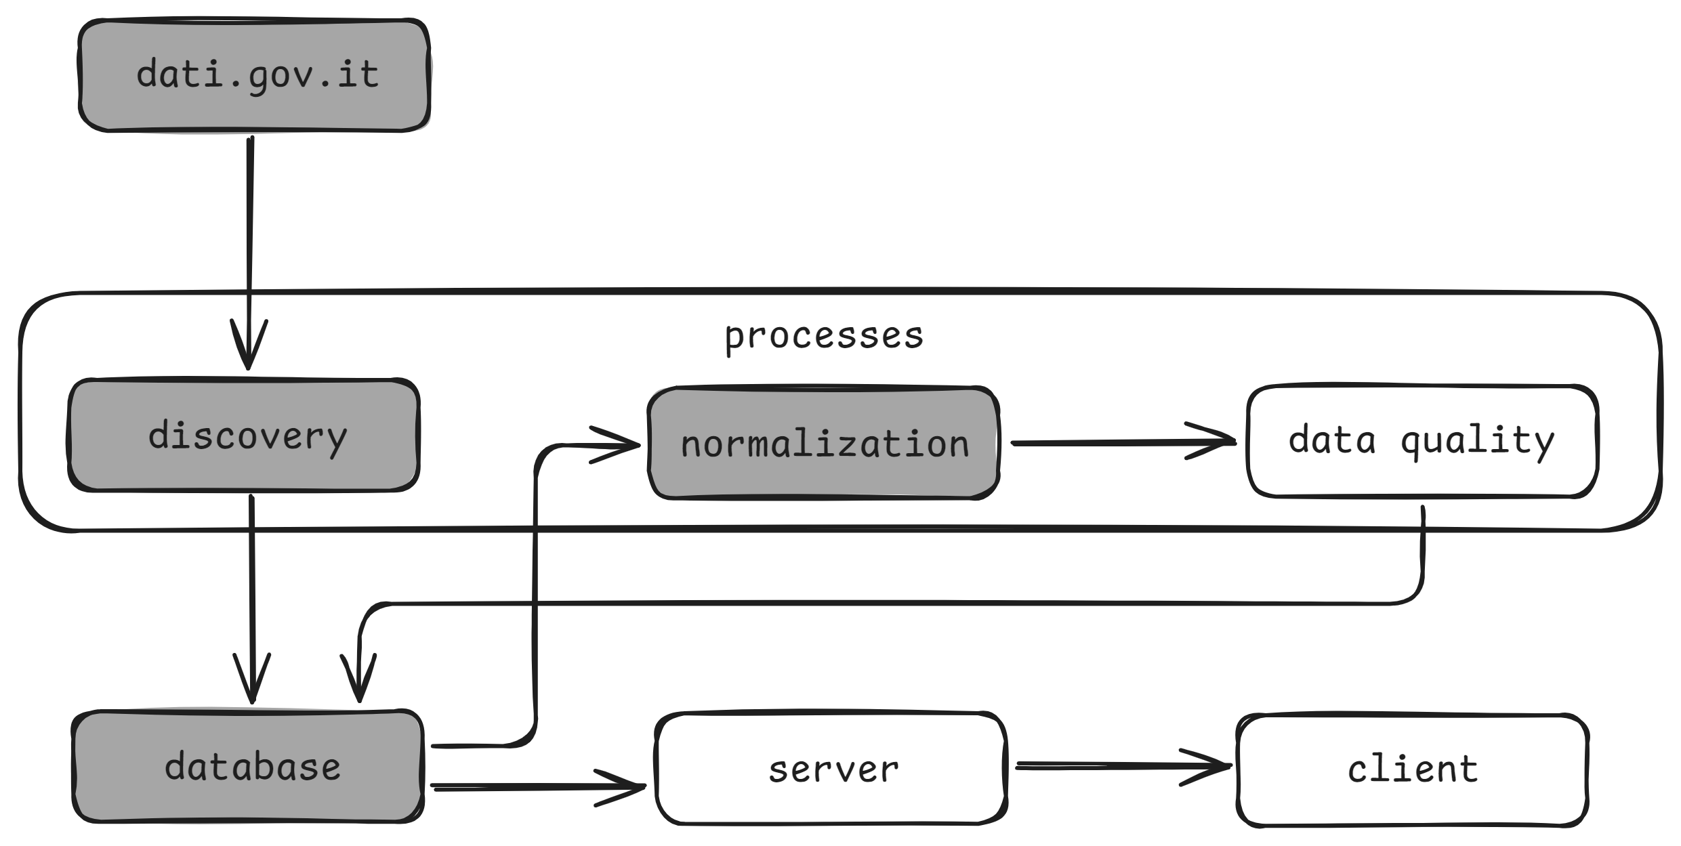
Data Quality
02. Implementation

Slide 23

Data Quality
generalized algorithm for calculating the data quality
scores for each measure
implemented in Python and in compliance with the
ISO/IEC 25012 and ISO/IEC 25024 standards
1. retrieve the dataframe
2. compute the quality measures
3. save the results in the database
02. Implementation
Notes:
-Now let’s see how we exactly measure data quality.

Slide 24
Data Quality
ACCURACY: the degree to which the data represents its true intended value
Acc-I-3: Data accuracy assurance
Acc-I-4-IT-1: Confidence of data set accuracy
AVAILABILITY: the degree to which the data can be retrieved
Ava-D-2: Probability of data available
COMPLETENESS: the degree to which the data has expected values for all properties
Com-I-1-IT-1: Data set completeness
Com-I-5: Empty records in a file
02. Implementation
Notes:
-The first one indicates the number of values for which it is possible to evaluate accuracy.
-The second one indicates the number of numerical outliers present in the data as calulated by the IQR method.
-It has a measure that indicates the number of times the data was available out of all access attempts.
-one indicating the number of single null values.
-and the other indicating the number of completely null rows.

Slide 25
Data Quality
CONSISTENCY: the degree to which the data is coherent and free of contradictions
Con-I-2-IT-1: Data type consistency
Con-I-3-IT-1: Confidence of data set consistency
Con-I-4-IT-1: Data structure consistency
Con-I-5: Data values consistency coverage
UNDERSTANDABILITY: the degree to which the data can be read and interpreted
Und-I-1: Symbols understandability
the measures are scored from 0.0 to 1.0 where values closer to 1.0 indicate better quality
02. Implementation
Notes:
-The second one measures the presence of duplications. The presence of duplicated values means less confidence in consistency since updating those values requires updating all their occurrences.
-Sometimes data can contain wrongly decoded characters such as accented letters or other special symbols. This measure indicates the degree to which comprehensible symbols are used in the data.

Slide 26
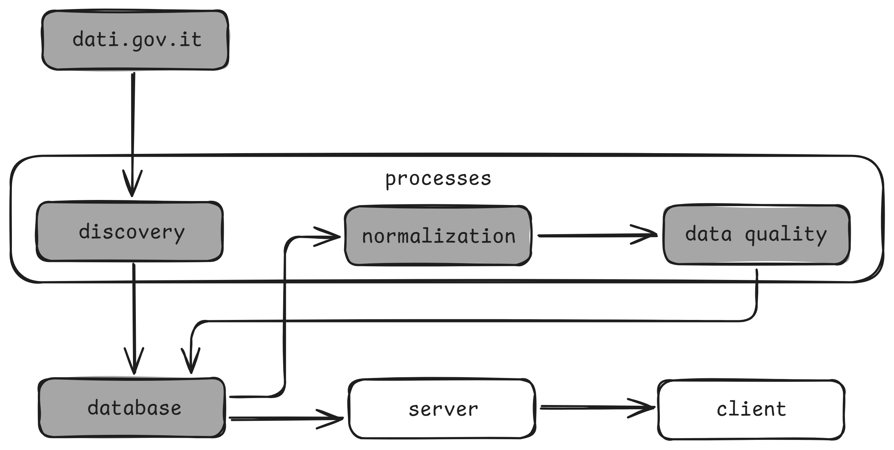
Server
02. Implementation

Slide 27
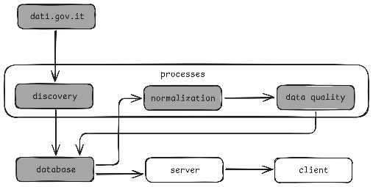
Server
implemented in Node.js and communicates
with the database through SQL queries
exposes API endpoints to publish the data quality results
1. for single dataset/resource
2. aggregated by:
group: Scienza e tecnologia, Governo e settore pubblico, Ambiente, Salute, Energia tag: air-quality, pista-ciclabile, attivita-recreative, segnaletica, software-development
organization: Comune di Torino, Ministero dell’Istruzione e del Merito, Politecnico di Milano
3. overall average
02. Implementation

Slide 28
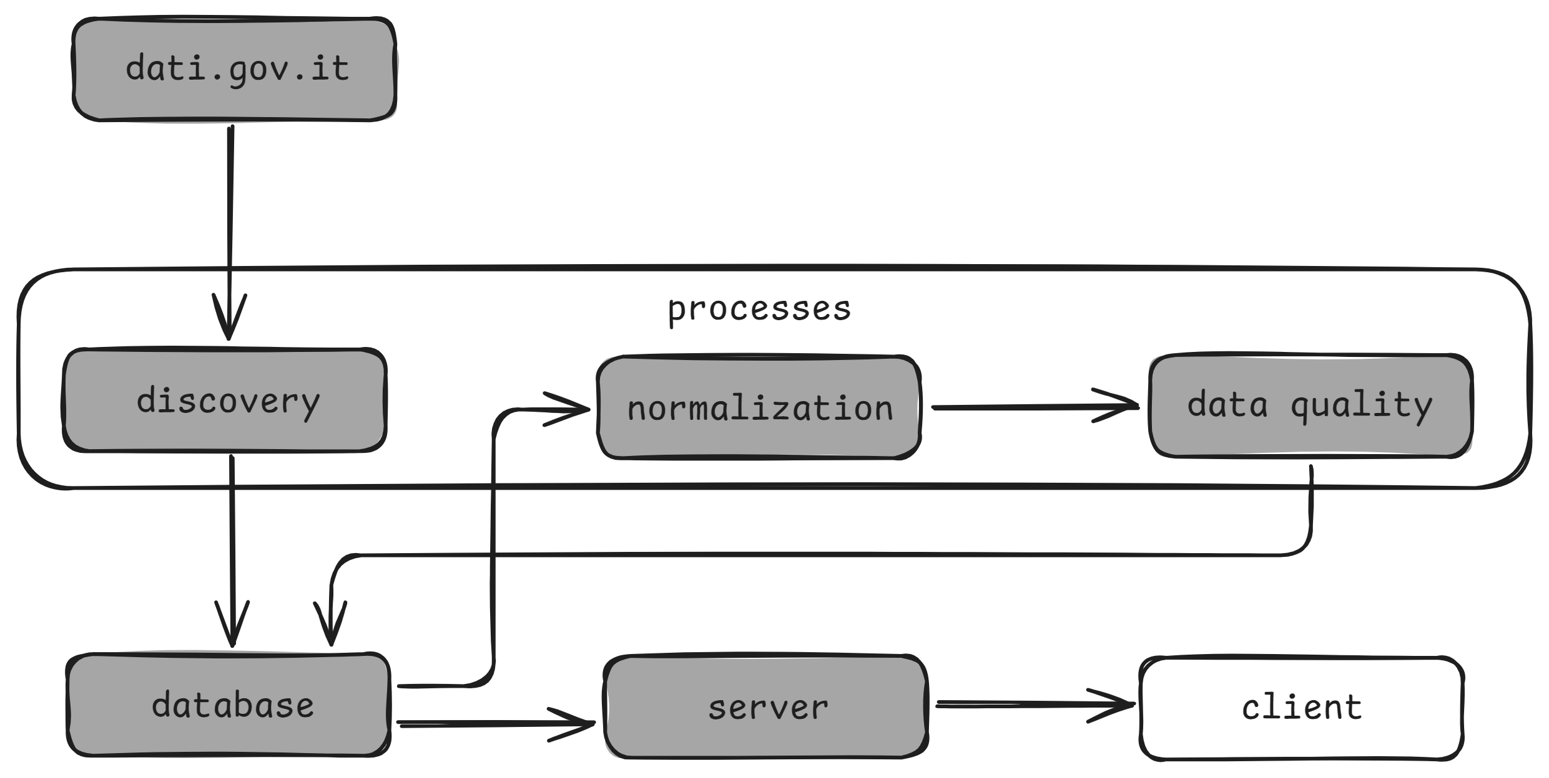
Client
02. Implementation

Slide 29
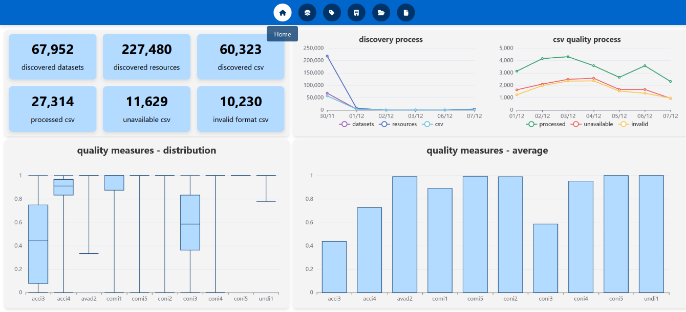
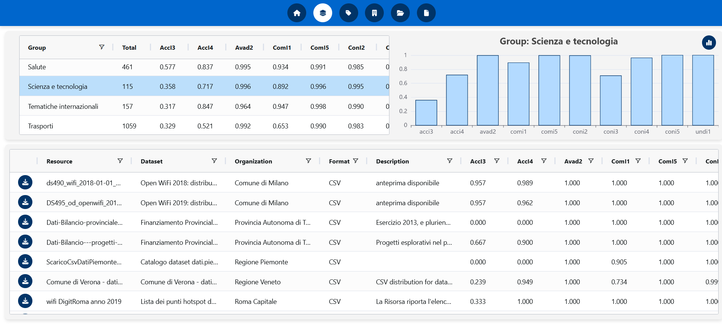
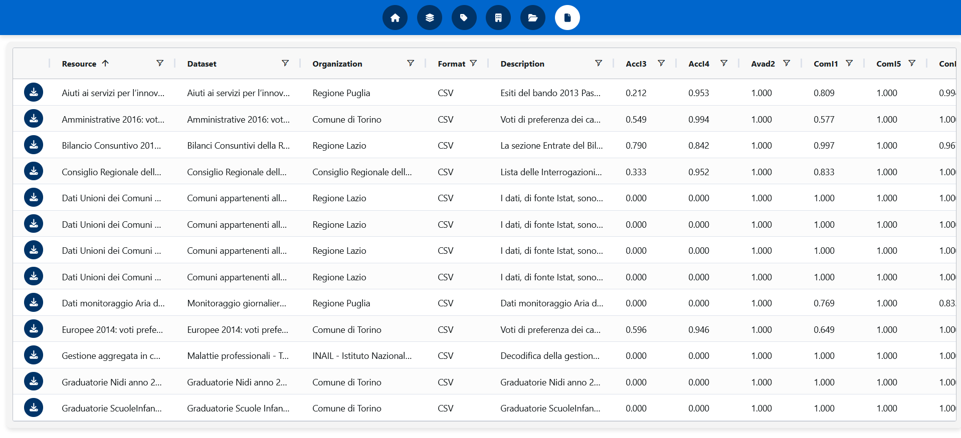
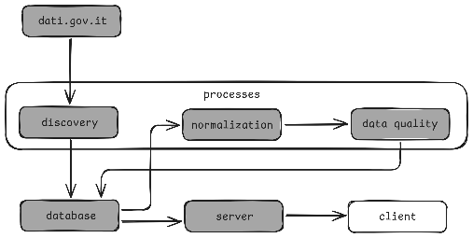
Client
an interactive dashboard for exploring metadata and quality measures
implemented in React with a user-centric design
different views that allow for an intuitive analysis of the results
02. Implementation

Slide 30
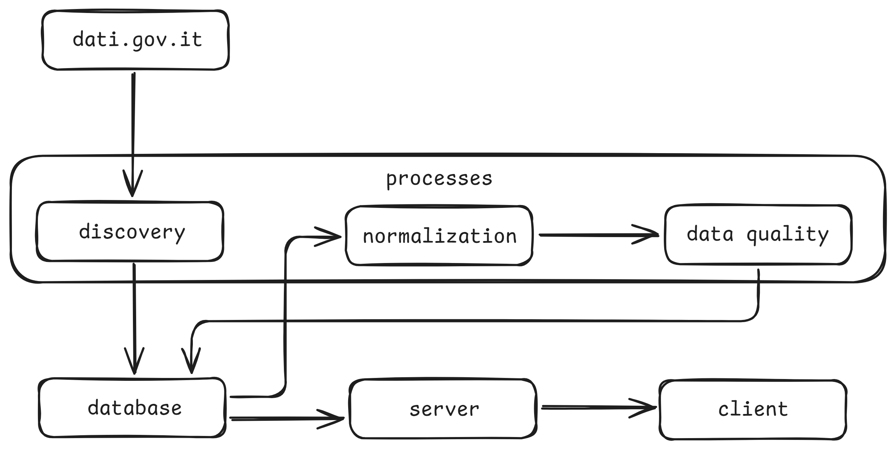
Architecture
source code
https://github.com/kristigjerko301101/open-data-quality
02. Implementation

Slide 31
A massive analysis of Italian open data quality
01. Introduction
02. Implementation
03. Live Demo
04. Conclusions

Slide 32
A massive analysis of Italian open data quality
01. Introduction
02. Implementation
03. Live Demo
04. Conclusions
Notes:
CTRL ALT TAB
START P

Slide 33
A massive analysis of Italian open data quality
01. Introduction
02. Implementation
03. Live Demo
04. Conclusions

Slide 34
Future Work
the metadata played a key role in creating this tool by enabling automated data ingestion, transformation, and quality evaluation
more complete metadata can allow for further improvements:
1. integrate other quality measures
the metadata «frequency» is available on the portal but rarely has a value
knowing the frequency, would allow us to introduce a Currentness measure (how up-to-date is the data)
2. integrate other resource formats
the CSV format makes up 25% of the total but there are other formats such as JSON, XML, XLSX
their variable structure makes it hard to develop a generalized normalization algorithm
metadata that describe the structure of the resource could help overcome that challenge
04. Conclusions

Slide 35
Final Remarks
The massive analysis of Italian open data quality reveals both promising signs and areas for improvement, underscoring the need for continuous monitoring and refinement.
By providing a scalable, automated, and user-focused solution, this tool makes a significant contribution to advancing
open data practices, ensuring that the promise of transparency and innovation is matched by the quality of the data itself.
04. Conclusions

Slide 36
A massive analysis of Italian open data quality
01. Introduction
02. Implementation
03. Live Demo
04. Conclusions

Slide 37
Thank you for your attention!
[1 ] Open Definition. (n.d.). The Open Definition. Consulted 10/11/2024, at https://opendefinition.org [2] European Union. (n.d.). The official portal for European data. Consulted 10/11/2024, at https://data.europa.eu/en/dataeuropa-academy/what-open-data [3] International Organization for Standardization. (2008). ISO/IEC 25012:2008(E). Software engineering - Software product quality requirements and evaluation (SQuaRE) - Data quality model. [4] Agenzia per l’Italia Digitale. (n.d.). I dati aperti della pubblica amministrazione. Consulted 12/11/2024, at https://www.dati.gov.it/chi-siamo [5] International Organization for Standardization. (2015). ISO/IEC 25024:2015(E). Systems and software engineering - Systems and software quality requirements and evaluation (SQuaRE) - Measurement of data quality. [6] Kristi Gjerko. (2024). A massive analysis of Italian open data quality.
Consulted 14/11/2024, at https://github.com/kristigjerko301101/open-data-quality [7] Marco Rondina. (2023). Experience: Bridging Data Measurement and Ethical Challenges with Extended Data Briefs.
Consulted 14/11/2024, at https://github.com/RondinaMR/data-qbd-framework

